Slide 1

Trusted and Responsible AI in the Construction Sector: Status and Challenges
26.04.2024
Nurul Awatif Mohd Asri
Nikhil Ahlawat
Aaron Guo
Ekan Emokpae
Prof. Yifan Zhao
Dr. Lichao Yang

Slide 2
CONTENTS
AI Applications in Construction
Implmentation Roadmap
Conclusion & Recommendation
Research Gaps
Identify the primary AI application in construction sectors
Integrating TRAI challenges with conceptual framework
Future works recommendation for developing TRAI models
Key points of this research
2
4
6
8
1
3
5
7
What is TRAI?
Literature Review
Case Study
Conceptual Framework
Defining TRUSTED and RESPONSIBLE Artificial Intelligence (AI) in construction
What is the challenges of implementation TRUSTED & RESPONSIBLE AI in AI applications
Site Monitoring is chosen as case study to apply developed framework
Based on literature review, conceptual framework is proposed

Slide 3
Introduction
The construction sector, traditionally conservative, exhibits a hesitancy towards new technologies. The digital transformation of the construction industry marks a significant leap towards innovation and sustainability, driven by the adoption of sophisticated tools such as artificial intelligence (AI).
As the industry embraces this profound change, it faces the challenges of ensuring data security, maintaining privacy, and boosting operational efficiency.
The integration of AI into construction processes presents a promising avenue to address these challenges, providing innovative solutions that could revolutionize the sector. Yet, deploying AI technologies introduces complex questions regarding trust, responsibility, and transparency in decision-making.
3

Slide 4
Aim
Develop a conceptual framework for managing trusted and responsible of AI specifically tailored for construction industry.
Objectives
Understand and define the concept of trusted and responsible AI in construction industry​
Extensive literature review of the challenges of trusted & responsible AI in the construction sector​​
Create a conceptual framework for deploying trusted and responsible AI solutions for construction.​
Implement the proposed conceptual framework in an AI application for site monitoring in construction.
4

Slide 5
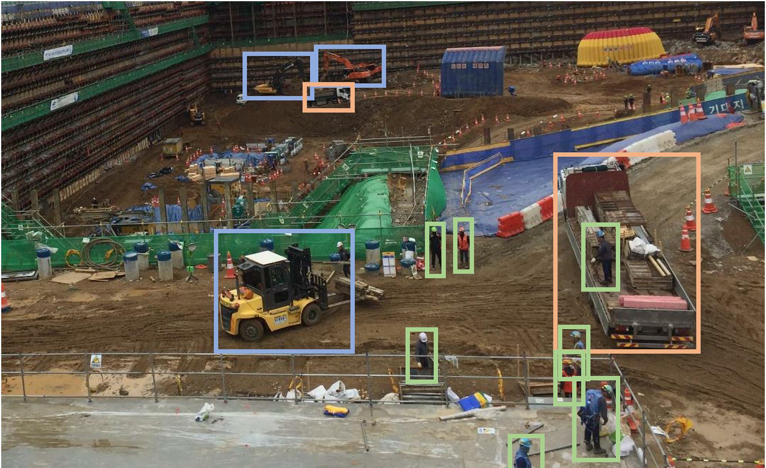
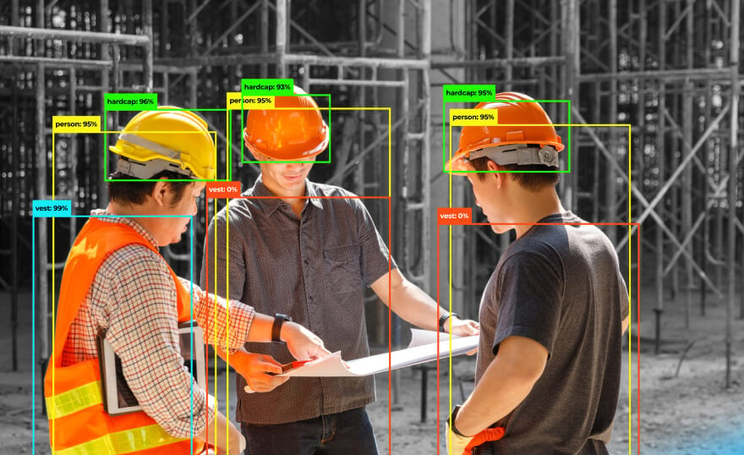
Trusted and Responsible Artificial Intelligence (TRAI)
DEFINITION:
Trusted and responsible Artificial Intelligence (TRAI) in the construction industry refers to the ethical and reliable use of AI technologies to enhance productivity, safety, and efficiency while ensuring transparency, accountability, and fairness in decision-making processes (Abioye et al., 2020).
5

Slide 6
Trusted & Responsible AI Elements
Trusted and Responsible AI
Transparency
Accountability
Privacy and Security
Safety and Reliability
Ethical Considerations
Sustainability
AI systems should be understandable by the people who use them.
Clear communication about how the systems work, what data they use, and how they arrive at decisions.
Addressing any errors or biases the systems may exhibit.
Mechanisms for holding designers and operators responsible.
Secure against unauthorized access and use.
Prioritize the protection of users’ personal data.
Safeguards to prevent failures and harm to humans.
Perform reliably and safely under every condition.
Compliance with legal and regulatory standards.
Engage stakeholders to reflect diverse perspectives.
AI in construction should consider environmental impact, helping to reduce waste through optimized planning and resource management.
Minimize harm and promote social and economic benefits for construction workers.
6
Notes:
This slide presents the core elements of Trusted & Responsible AI, which are essential for ethical AI development and deployment. Transparency ensures AI systems are understandable to users, while Accountability addresses errors and biases. Privacy & Security are about protecting personal data, and Safety & Reliability emphasize safeguards against failure. Ethical Considerations require compliance with laws and the inclusion of diverse perspectives. Lastly, Sustainability focuses on minimizing environmental impact and promoting social and economic benefits, exemplified here with AI in construction to optimize resource management and reduce waste.

Slide 7


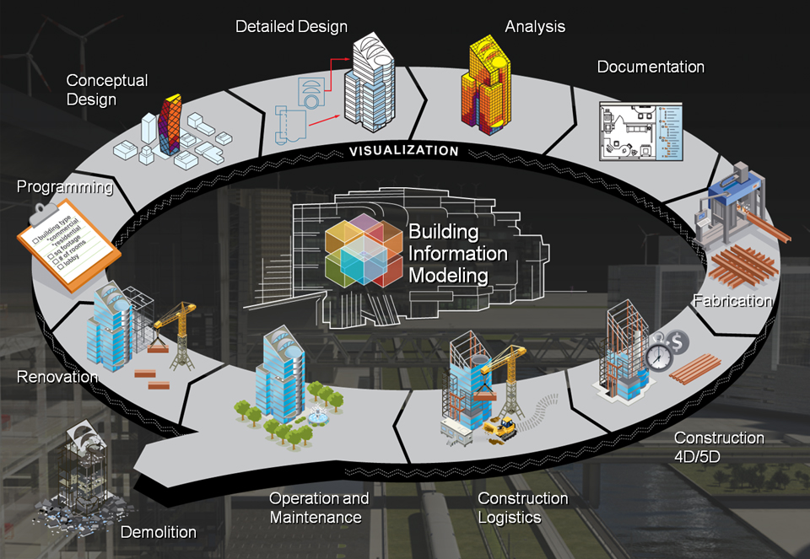

Literature Review: Primary AI Applications in Construction
Primary AI Applications
Design & Planning
Predictive Maintenance
Supply Chain Optimization
Safety Management
Quality Control
Sustainability
Data analysis for cost-effective, high-performance designs.
Sensor data analysis for equipment maintenance needs.
Forecasting, inventory management, transport logistics
Detecting unsafe behaviours/ conditions via sensors/ CCTV
AI-based image processing for defect detection
Site Monitoring
BIM Integration
Leverages historical data for insights and digital operations.
Real-time safety hazard identification, progress tracking.
Building energy management and consumption pattern prediction
Project Improvement
Cost Savings
Performance Improvement
Project Automation
Insightful Information
Resource Control
Safety Hazards
Project Progress Tracking
Project Schedule Adherence
Sensor Data Analysis
Downtime Reduction Planning
Improved Maintenance Planning
Project Planning & Design Optimization
Site Monitoring & Management Information
7
Building Information Modelling (BIM)
Predictive Maintenance
Notes:
This slide from our literature review outlines the primary applications of AI in the construction industry. In Design & Planning, AI enables data-driven decision-making for cost-effective, high-performance designs. BIM Integration uses historical data to enhance insights and digital operations. For Site Monitoring, AI provides real-time safety hazard identification and progress tracking. Predictive Maintenance utilizes sensor data to foresee equipment needs, while Supply Chain Optimization applies AI for efficient inventory and transport logistics. Safety Management AI detects unsafe behaviors, and Quality Control uses AI for defect detection. Lastly, Sustainability is addressed with AI optimizing energy management and predicting consumption patterns, ensuring a future where construction is as smart as it is solid.

Slide 8
Literature Review: Challenges in Trusted & Responsible AI
PROPER TRAINING:
Implement a comprehensive training programme for project planners, designers, & construction teams, with a particular focus on TRAI regulations, guidelines, and best practices
INTEGRATION WITH EXISTING SYSTEMS & WORKFLOW:
Developing new communication protocols or data formats to ensure compatibility between systems.
DATA PRIVACY & SECURITY:
Implement robust encryption protocols and access controls. Conduct regular security audits and ensure compliance with privacy regulations.
HIGH IMPLEMENTATION COST:
Conduct cost-benefit analysis. Explore phased implementation or cloud-based solutions to mitigate upfront costs.
INTEGRATION DIVERSE TECHNOLOGIES:
Develop standardized data formats and protocols for seamless interoperability. Utilize middleware solutions or APIs for data exchange.
LACK OF STANDARD EVALUATION METRICS:
Proposed various evaluation metrics, such as prediction accuracy, mean squared error, and precision and recall.
8
Notes:
Following are the challenges bas on our literature review for primary AI applications and the applications considered are Site monitoring, Predictive maintenance, BIM and design and planning.

Slide 9
Research Gaps
Lack of Industry-specific Ethical Frameworks: Limited research on ethical AI frameworks tailored to the unique challenges of the construction industry.
Data Management and Governance: Insufficient studies on the governance of data in construction, including collection, storage, and usage policies.
Integration with Legacy Systems: Limited guidance on how AI can be integrated with older, non-digital systems prevalent in the construction industry.
Performance Metrics: A gap exists in standardized metrics for evaluating the performance and impact of AI in construction projects.
9
Notes:
Here are the key research gaps in the application of AI within the construction industry. Firstly, there's a need for industry-specific ethical frameworks, as current research is limited in addressing the unique ethical challenges AI presents in construction. Secondly, the integration of AI with legacy systems is poorly understood, with limited guidance available for blending new AI technologies with older, non-digital systems. Thirdly, data management and governance within construction require further study, particularly regarding how data is collected, stored, and used. Lastly, there is a notable lack of standardized performance metrics to evaluate the impact and effectiveness of AI in construction projects. Addressing these gaps is critical for the responsible and efficient adoption of AI technologies in the field.

Slide 10





Keywords to Develop Conceptual Framework
Transparency and Explainability
Operational Efficiency
Continuous Learning
and improvement
Stakeholder Engagement
Trusted &
Responsible Al
Regulatory Compliance & Standards
Security and Reliability
Sustainable and
Socially Beneficial Al
Ethical Principles
and Standards
10
Notes:
The core keywords of the framework define the content of our framework as well as the development plan. Next, I am going to present the keywords of the development conceptual framework as well as a detailed framework diagram. The diagram shows that eight keywords are included and they are .... The diagram shows how these elements relate to each other. Each element demonstrates how TRAI elements interact with each other to form an ecosystem that aligns stakeholder values, ethical considerations, and continuous progress with society's expectations and emerging technologies. This is the main goal of the framework.

Slide 11
Keywords to Develop Conceptual Framework
Open Algorithms
Decision Explanation
Predictive Maintenance
Ongoing Training
Documentation
Performance Analytics
Innovation Encouragement
Resource Optimization
Adaptive Frameworks
Real-time Monitoring
Continuous Feedback
Certification
Trusted &
Responsible Al
Best Practices
Co-creation of Solutions
Inclusive Consultation
Legal Compliance
Cybersecurity Measures
Economic inclusion
Regular Audits
Environmental
Sustainability
Robustness and Safety
Social lmpact
Privacy and Data Protection
Fairness and Non-discrimination
Accountability and Transparency
11
Notes:
This diagram gives a more specific explanation in detail, as an example, we can improve operational efficiency through predictive maintenance, performance analytics, resource optimisation, real-time monitoring. Each element in the diagram focuses on ensuring that AI is applied in a way that is trustworthy, ethical and beneficial to the construction industry.

Slide 12
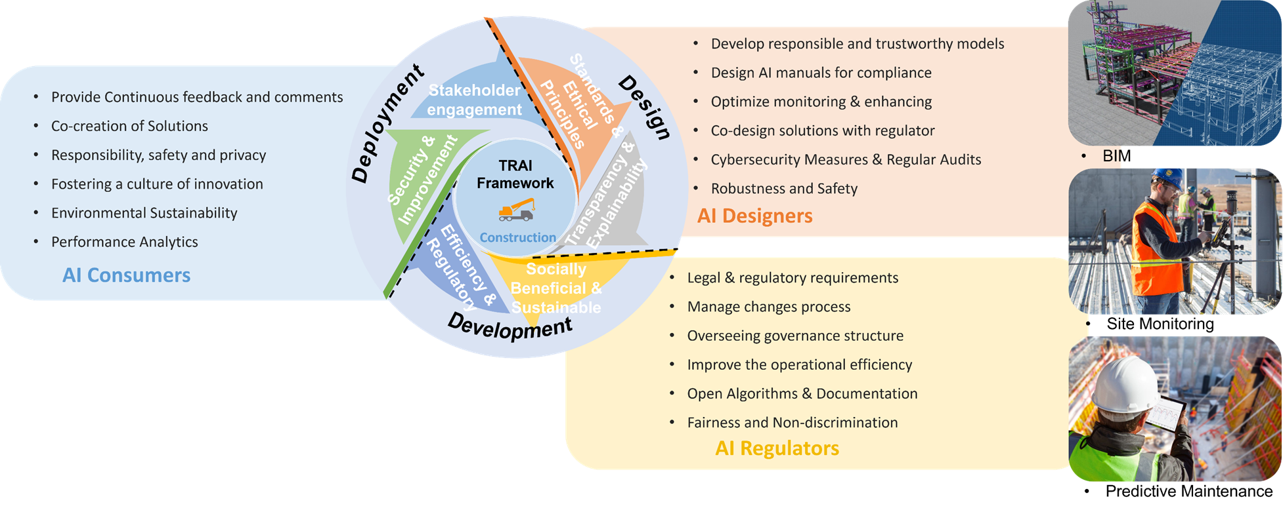
Conceptual Framework & Application in Construction
12
Notes:
I want to talk about a strategy that is setting a new standard in the construction industry: we created a framework like this, which includes ethical standards, safety, and responsibility. Think of this framework as a wheel with three spoke: design, development and deployment. Each stage is necessary and essential to keep the wheel moving smoothly and to ensure that all stakeholders - AI designers, regulators, and consumers - play their part in moving forward responsibly.
1.In the design phase, AI designers are at the helm. Their task is to conceive AI solutions that are not only trustworthy and responsible, but also meet strict criteria for compliance.
2.The development phase is when these plans take shape and are tested to ensure that they benefit society and respect our environment. In this phase, collaboration with stakeholders is crucial. Everyone affected by the implementation of AI has a voice to participate and give good advice.
3.We then move to the deployment phase, integrating the AI solution into the construction site. The consumers of AI, the end users, become the focus of attention. They play a key role in providing feedback, collaborating on solutions, and fostering a culture that values innovation, safety, and environmental stewardship.
In short, the framework is more than a guideline; it is a promise to the construction industry that it is possible to use AI not only to build buildings, but also to build a tradition of innovation, ethical practice, and human responsibility.

Slide 13
Implementation Roadmap
TRAI Challenges
Conceptual Framework
Implementation in Site Monitoring
Lack of evaluation metric
Data Quality & quantity
Design Phase:
Standard Ethical Principles
Transparency & Explainability
AI Designer: Manuals include guidelines for using face blurring techniques while monitoring PPE compliance & worker activities.
AI Regulators: Tools used in face blurring compliance with GDPR standards by putting data privacy at the forefront of their operations while ensuring use.
AI Consumers: Determine the system affects efficiency, privacy protection, and safety by machine tracking, face blurring and PPE kit detection.
Accuracy & reliability AI models
Legal & Ethical issue
Development Phase:
Socially Beneficial & Sustainable
Efficiency & Regulatory
Lack of real-world data
Data Privacy & security
Deployment Phase:
Stakeholder Engagement
Security & Improvement
01
02
03
13
Notes:
This is a roadmap for implementation, and when we meet challenging issues for TRAI, we create a framework for development based on the different issues on a one-by-one approach.
Then There is a division of responsibilities between designers, regulators and consumers working together. The case study will be introduced by Nu.

Slide 14
Case Study: Site Monitoring
Site Monitoring AI Application
1. Proxxi
2. Smartvid.io
3. OpenSpace
4. BrickControl
Human Behavior Monitoring
Safety: PPE compliance
Work Patterns: Worker’s activities or movements
Machine Behavior Monitoring
Performance Metrics: Machine tracking
Fatigue Detection: Workers' signs of fatigue
Data Privacy: Face blurring
Anomaly Detection: Abnormal vibrations/ temperature/ noise
Energy Consumption: Energy efficiency & cost saving
Predictive Maintenance: Historical data & performance trends
14

Slide 15
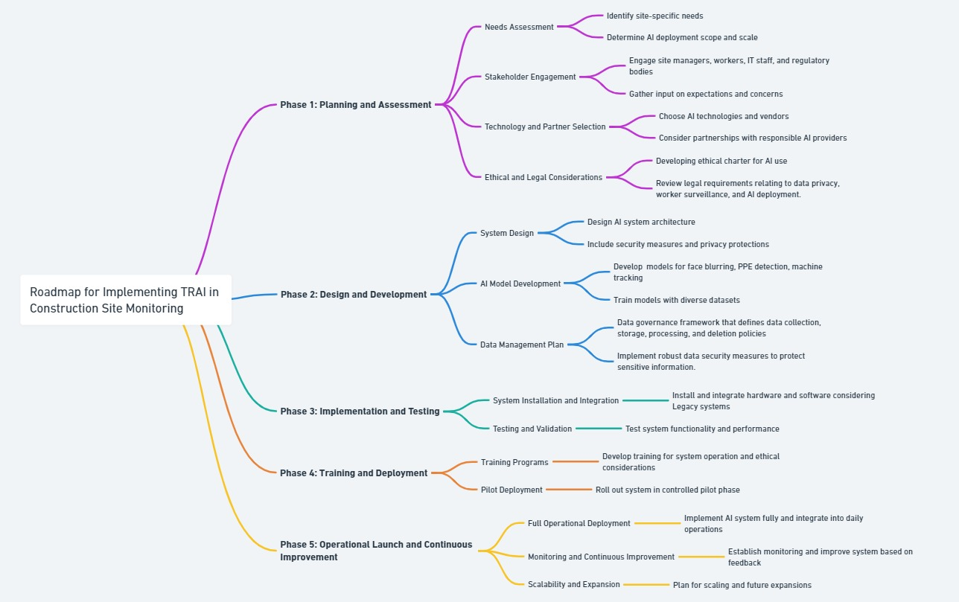
Framework implementation in Case Study: Site Monitoring
15

Slide 16
Benefits of Implementing Trusted & Responsible AI Framework in Site Monitoring
Benefits
Enhanced Safety and Risk Management
Increased Operational Efficiency
Improved Compliance and Documentation
Data Privacy and Security
Worker and Community Trust
Scalability and Flexibility
Environmental Impact
Enhanced Decision Making
16
Notes:
1. Enhanced Safety & Risk Management - safety risks and PPE non-compliance, allowing for proactive prevention and automated alerts for prompt corrective action.
2. Increased Operational Efficiency - AI maximizes the use of equipment and resources, enhances project deadline adherence, and lowers operating costs.
3. Improved Compliance and Documentation - Automated keeping track provides an audit trail for legal and review purposes
4. Data Privacy and Security - Protects sensitive data and complies with privacy laws by putting privacy-preserving techniques like face blurring and safe data management
5. Worker and Community Trust - By adhering to principles of fairness, transparency, and privacy.
6. Scalability and Flexibility - As AI gain machine learning experience, they get more accurate and efficient over time.
7. Environmental Impact – AI tracking and optimizing the use of materials and energy.
8. Enhanced Decision Making - offer in-depth understanding of site operations, facilitating more effective strategic planning and decision-making.

Slide 17
TRAI VS AI
Aspect | Regular AI | Trusted & Responsible AI (TRAI)
Objective | Optimizes specific objectives like efficiency or accuracy. | Balances performance with ethical, legal, and societal considerations.
Focus | Technical capabilities and task automation. | Ethical design, transparency, fairness, and user trust.
Data and Bias | Relies on data; may perpetuate existing biases. | Actively seeks to identify and mitigate biases; promotes fairness.
Transparency | Often "black box," with limited understanding of decision processes. | Prioritizes clear explanations of decisions; enhances user understanding.
Accountability | Compliance with current regulations. | Proactive in accountability; ready for future regulations and ethical standards.
Privacy & Security | Basic data handling, with potential privacy concerns. | Robust privacy protection and data security; complies with stringent regulations.
Sustainability | Not typically a primary consideration. | Integrates environmental and social sustainability into AI design.
Continuous Learning | Performance improvement focused. | Ongoing ethical, social, and technical improvement.
Examples | Standard analytics tools, generic chatbots, automation software. | AI with privacy-preserving features, explainable AI systems, ethical AI governance.
17

Slide 18
Conclusion
Conceptual framework developed as a guiding principles for development, deployment and use of trusted & responsible AI in construction. It establishes governance mechanisms and regulatory compliance measures to oversee AI adoption in the construction sector.
Recommendation
Focusing on rigorous model validation, prototype development, stakeholder engagement and continuous improvement are critical to unlocking the full potential of AI in mitigating risks.
Implementing trusted and responsible AI conceptual framework into AI application to maximize the efficiency of mature model development.
Developing input from stakeholders, designers, regulators, and customers for continuous improvement to achieve full operational efficiency.
18

Slide 19
www.cranfield.ac.uk

